Slide 1


Front end
(Html)
Lecture-7

Slide 2
Today’s Agenda
How to work with forms
How to work input controls

Slide 3
What is an HTML Form ?
HTML Forms are an integral part of the web page and their basic purpose is to collect information from the user.
They are commonly used to allow users to :
register on a Web site
log in to a Web site
order a product
send feedback
search for some information
HTML forms collect all this data and pass it to the server

Slide 4
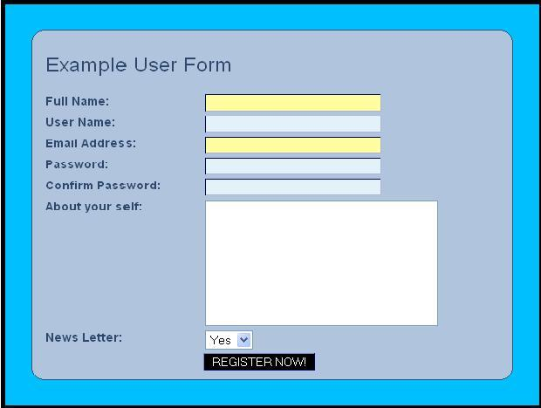
A Sample Registration Form

Slide 5
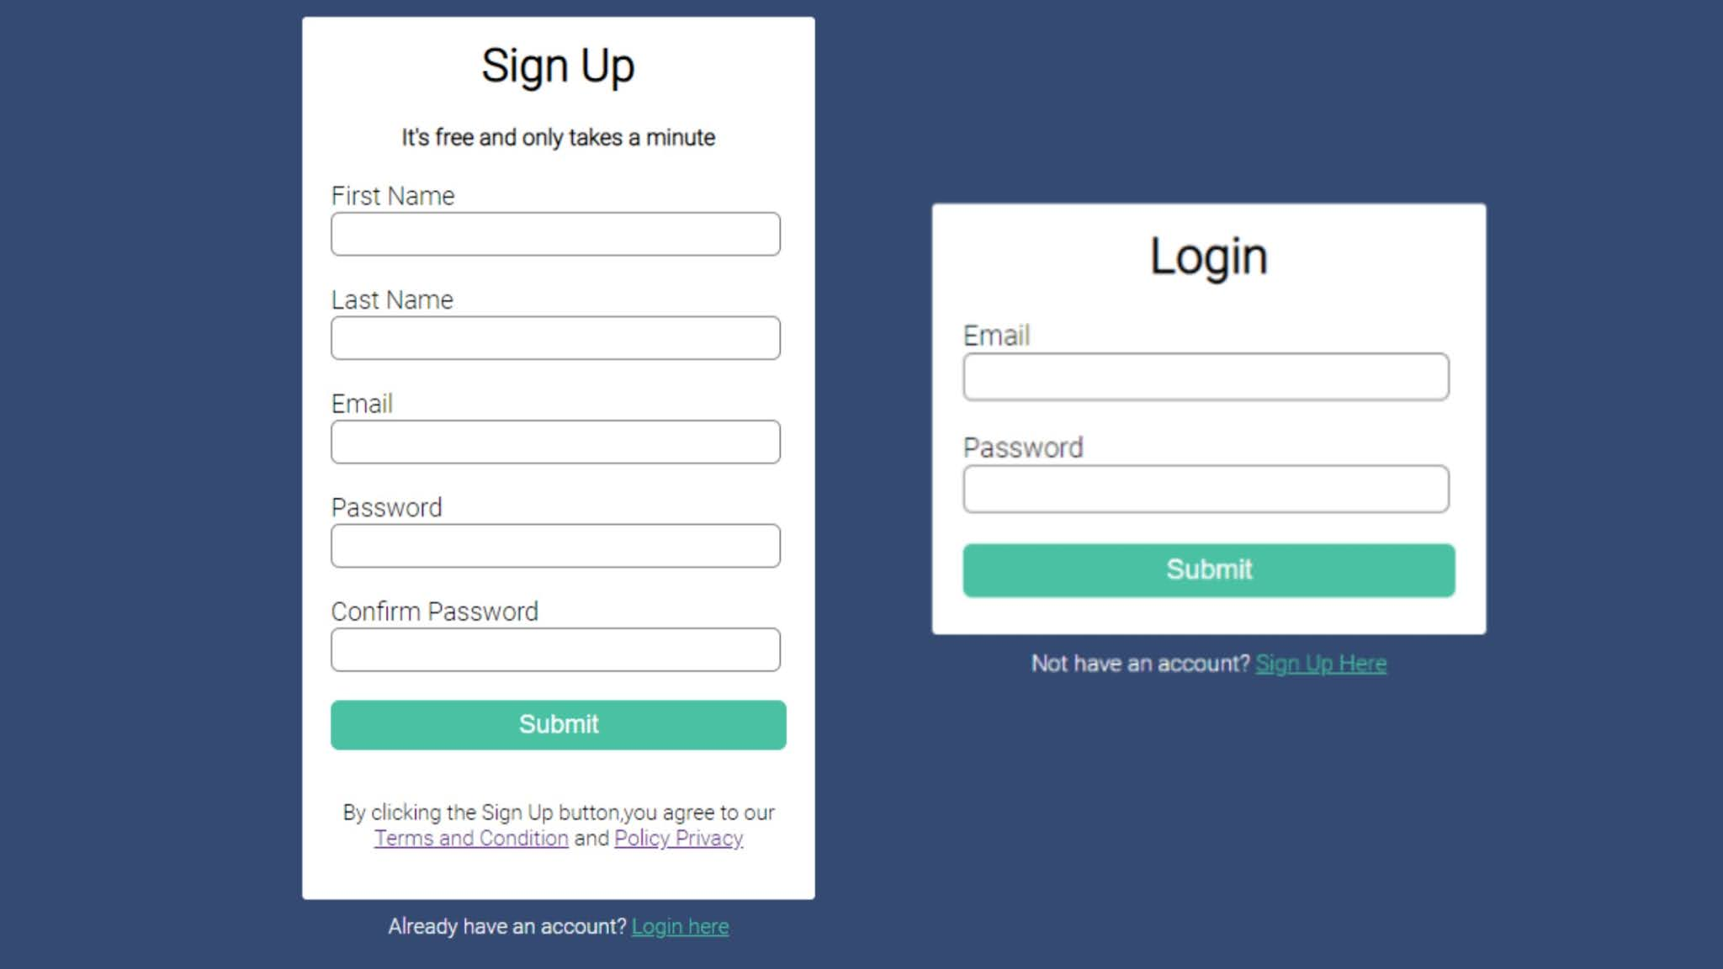
A Sample SignUp & Login Form

Slide 6
Creating an HTML Form
To create an HTML form we use the <form> tag.
Syntax :
<form action=“.....” method=“.....”> . input controls . </form>

Slide 7
What are “input controls” ?
An HTML form can contain GUI elements like
Text fields
Checkboxes
Radio-buttons
Lists
and many more.
These all are called “input controls” because users use them for inputting data.

Slide 8
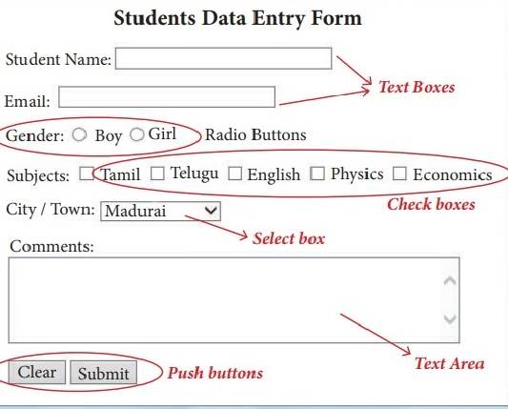
What are “input controls” ?

Slide 9
Tags For Input Controls
Input controls are generated using 3 types of tags:
Input
TextArea
Select

Slide 10
The <input> Tag
The HTML <input> element inserts one of many types of controls in form, usually destined to collect information provided by the user.
The type of control displayed depends on the "type" attribute which may take one of the nine values given in next slide.

Slide 11
The <input> Tag Controls
text
password
checkbox
radio
submit
reset
button
image
file

Slide 12
General Syntax of “input” Tag
<input
type=“ . . .”
name=“. . .”
size=“. . .”
maxlength=“. . .”
value=“. . .”
checked=“. . .“
>

Slide 13
Creating “textboxes”
The TextBox is the most common input type and to make HTML easier, is the default for the <input> tag.
This tag lets our readers type in any text information into the box.
To create a TextBox we set the “type” attribute to the value “text” which creates a single line text box of the specified size.
If size is not given the TextBox is of 20 characters
Syntax:
<input type=“text” >

Slide 14
Example 1
<form> First name: <input type="text" name="firstname"><br> Last name: <input type="text" name="lastname"> </form>

Slide 15
Creating “password fields”
The password field looks almost identical to the TextBox.
However, when we type in it, the letters are hidden.
The passwords are not sent encrypted in any way.

Slide 16
Creating “password fields”
To create a Password field we set the “type” attribute to the value “password” which creates a single line text box of the specified size.
If size is not given the textbox is of 20 characters
Syntax:
<input type=“password” >

Slide 17
Example 2
<form> User Name: <input type="text" name=“username"><br> Password: <input type=“password" name=“pwd"> </form>

Slide 18
Creating “Checkboxes”
A checkbox is a control that allows users to switch them between two values: checked and unckecked.
This type of control can be useful to ask multiple answer questions .

Slide 19
Creating “Checkboxes”
A good example of its use can be a form where the user must select topics of interest (reading, movies, music, coding, shopping etc.).
To create a Checkbox we set the “type” attribute to the value “checkbox”.
Syntax:
<input type=“checkbox” >

Slide 20
Example 3
<form>
Select the languages you know:<br><br>
<input type="checkbox" name="checkbox1"><b>C</b><br>
<input type="checkbox" name="checkbox2"><b>Php</b><br>
<input type="checkbox" name="checkbox3"><b>C++</b><br>
<input type="checkbox" name="checkbox4"><b>Java</b><br> </form>

Slide 21
Using “checked “ Attribute
A checkbox element can be placed onto a web page in a pre-checked fashion by setting the checked attribute.
It is a boolean attribute which if present loads the checkbox with ON status
Syntax:
<input ... checked />
OR
<input ... checked="checked" />

Slide 22
Creating “RadioButton”
Just like a CheckBox a RadioButton is also used to offer the user a set of predetermined choices.
But it can offer a single selection at a time.
To create a RadioButton we set the “type” attribute to the value “radio”.
Also we need to set the “name” property of all radios to the same value to make them mutually exclusive.
Syntax:
<input type=“radio” >

Slide 23
Example 4
<form>
Your Gender:<br><br>
<input type="radio" name="gender" ><b>Male</b><br>
<input type="radio" name="gender"><b>Female</b><br>
</form>

Slide 24
Creating “Submit Button”
A submit button is used to send form data to a server. The data is sent to the page specified in the form's action attribute.
The file defined in the action attribute usually does something with the received input
Syntax:
<input type=“submit” >

Slide 25
Example 5
<form action=“Login.py“ > Username: <input type="text" name="user"><br> Password: <input type=“password" name="user"> <input type="submit" value=“Login"> </form>

Slide 26
Creating “Reset Button”
A reset button is used to reset the form to it’s original state clearing all user input.
Syntax:
<input type=“reset” >

Slide 27
Example 6
<form name="input" action=“register.jsp" method="get">
Username: <input type="text" name="user"><br> Password: <input type=“password" name="user"> <input type="submit" value="Submit">
<input type=“reset" value=“Reset"> </form>

Slide 28
Creating “Button”
Setting the HTML input element's type attribute to "button" will render a button with no specific behavior.
Unlike the "submit" type of input this type will not automatically submit a web form.
We use this button type input for engaging users in Javascript functionality on our pages
Syntax:
<input type=“button” onclick=“fun_name()” >

Slide 29
Example 7
<form >
Your name: <input type="text”><br> <input type=“button" value=“Click Me“ onclick=“showmsg()”> </form>

Slide 30
Creating “image button”
Image button’s are images used as buttons
Image buttons have the same effect as submit buttons. When a visitor clicks an image button the form is sent to the address specified in the action setting of the<form> tag.
Setting the HTML input element's type attribute to “image" and using src attribute for image path will render a image as button
Syntax:
<input type=“image” src=“name of image” >

Slide 31
Example 8
<form name="input" action=“register.js" method="get">
Name: <input type="text"><br>
Contact No:<input type="text"><br>
Gender:<input type="radio" name="gender">Male<input type="radio" name="gender">Female<br>
<input type="image" src="../images/button_register.gif" >
</form>

Slide 32
Creating “file upload” button
Setting the HTML input element's type attribute to "file" will render a file upload field in a web <form>.
This allows a user to browse their computer for a file to upload.
The user places their selected file in the file field and continues filling out your form and all data can be parsed at once when they press submit.
Syntax:
<input type=“file” >

Slide 33
Example 9
<form enctype="multipart/form-data" action=“upload.js" method="post">
<p>Browse for a file to upload: </p>
<input type="file" name="uploaded_file">
<br /><br />
<input type="submit" value="Upload It Now">
</form>

Slide 34
What Is enctype ?
This attribute specifies that data present in form should be encoded when submitting to the server.
Syntax:
<form enctype=“…” >

Slide 35
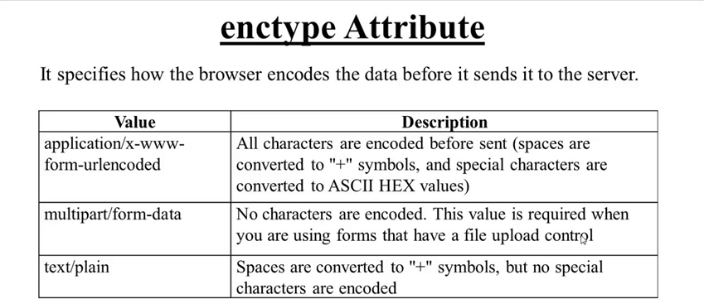
Three Possible Values For enctype

Slide 36

End Of Lecture
For any queries mail us @: scalive4u@gmail.com
Call us @ : 0755-4271659, 9826686245
Agenda for Next Lecture:
Using Select Control
Working with TextArea

